Slide 1

O-Group APP
Joshua Paterson - B.Eng (Computer and Software Systems)

Slide 2
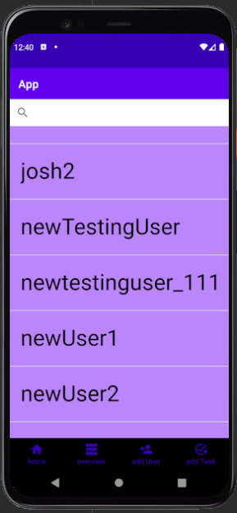
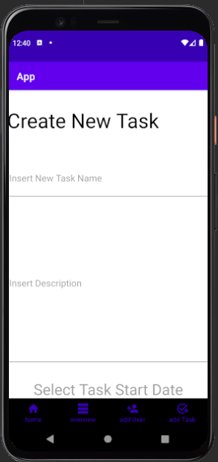
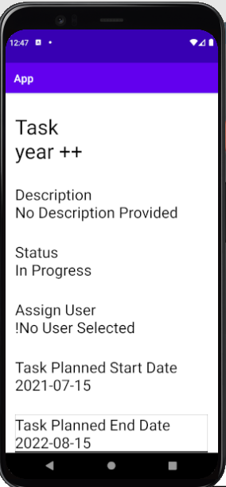
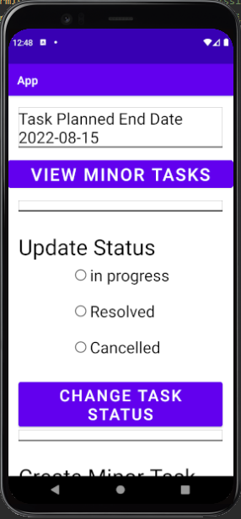
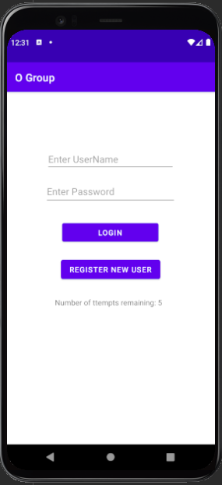
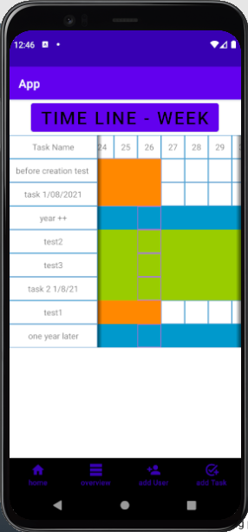
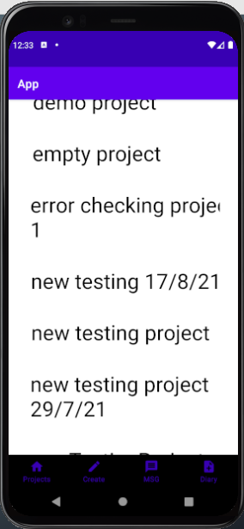
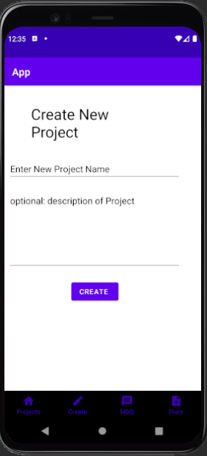
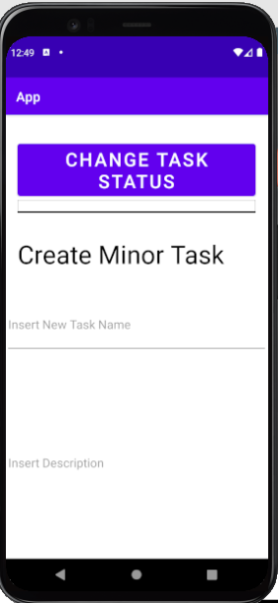
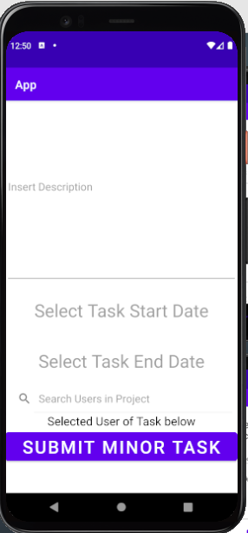
What is O Group

Slide 3
Project Objectives

Slide 4
Security
Why a Custom Solution
Australian Government Information Security Manual – Australian Signals Directorate
Key exchange method
Constraints
Ios kill codes
Web app

Slide 5
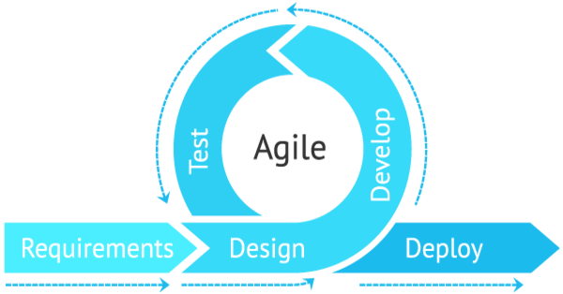
Capability
Iterative development

Slide 6
Recap of design decisions
Java application
AES-256 for general encryption
RSA-3072 for key exchange
SHA-2-384 with salt for one way data encryption
Capability choices will likely be a continually evolving/iterating process

Slide 7
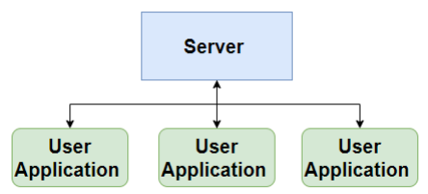
architecture of the app
Overarching approach
Object-oriented programming (OOP) – programming model
Agile Development Methodology
High level Data Flow Overview

Slide 8
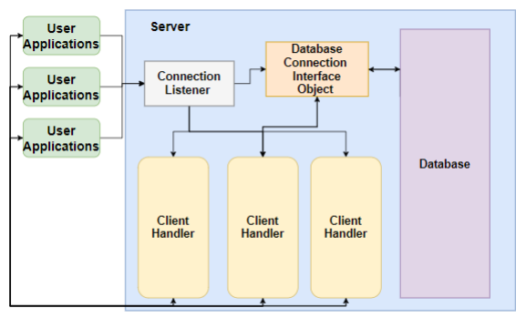
Server

Slide 9
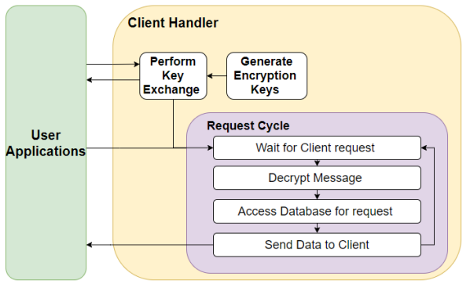

Slide 10
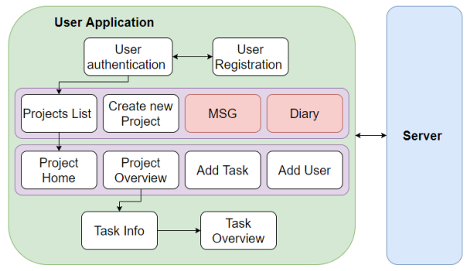
User applications

Slide 11
Application in its current state
Structure and networking implemented
Encryption algorithms implemented
Some basic functionality

Slide 12
Future works
Further Capability Development
Deployment
UX testing

Slide 13
Questions

